Slide 1
Food Stall system in Java

Slide 2
ABSTRACT
Now a days many applications are used for food management system but with some issues.
The issues may be time management, stock management etc., which will leads to broken the customer satisfactions and quality problems.
For avoiding this we implement a fool stall system which will overcome the above declared statement.
We maintain our system with admin and user panel which provides better understandable for both user and management.
Result show our proposed system minimize the manpower and delay between the food order.

Slide 3
OBJECTIVE
The aim of this project is to create a food stall management system that can incorporate the benefits of all the existing solutions but without any of the drawbacks as well as including many new features.

Slide 4
EXISTING SYSTEM
In Existing system, they use man power related food serving system.
Which may leads to following problems
Unmanageable order logging.
Inefficient restaurant-kitchen communication.
Difficult order tracking and time management.
Difficult stock management.
Limited statistical output.

Slide 5
DISAVANTAGES
Time delay
Need high man power

Slide 6
PROPOSED SYSTEM
Propose a food stall management system for both use and admin.
The aim of this project is to create a food stall management system that can incorporate the benefits of all the existing solutions but without any of the drawbacks as well as including many new features.

Slide 7
ADVANTAGES
User friendly
Quick delivery
Less Man power

Slide 8
SYSTEM REQUIREMENTS

Slide 9
SOFTWARE AND HARDWARE REQUIREMENT
Hardware Specifications
System : Pentium IV 2.4 GHz
Hard Disk : 160 GB
Monitor : 15 VGA color
Mouse : Logitech.
Keyboard : 110 keys enhanced
Ram : 2GB

Slide 10
Software Specifications
O/S : Windows 7.
Language : Java.
IDE : NetBeans 8.2
Data Base : MySql

Slide 11
DIAGRAMS

Slide 12
SYSTEM ARCHITECTURE
Admin
Admin Login
Food Added
Delete the food
Order message send to the user
Order message receive the user
Order send to the admin
Order Placed
User
User Login
View the food
Food added to the cart

Slide 13
FLOW DIAGRAM
User
Admin
User Login
Admin Login
View the food
Food Added
Food added to the cart
Delete the Food
Order Placed
Order message send to the user
Order send to the admin
Order Message receive the user.

Slide 14
CLASS DIAGRAM
User
Food added to the cart
Admin
User Login
Order Placed
Admin Login
View the Food
Order send to the admin
Food Added
Delete the food
Order message send to the user.
Order message receive the user.

Slide 15
USE CASE DIAGRAM
Login
View the Food
Food added to the cart
Order Placed
Order send to the admin
User
Admin
View the Food
Order message send to user
Order message receives the user

Slide 16
SEQUANTIAL DIAGRAM
User
Admin
Order
Order send to the admin.
User Login
Admin Login
Order message passes to the user
View the Food
Food Added
Order message receive the user
Food added to the cart
Order Placed

Slide 17
ER DIAGRAM
User Login
View the food
Food added to the cart
Admin Login
Food Added
Order placed
User
Admin
Order send to admin
Order message send to the user
Order message receive the user
Order

Slide 18
MODULES

Slide 19
MODULES
Admin Stock Management
User Authentication
Cart items
Delivery status

Slide 20
MODULES EXPLANATION

Slide 21
Admin Stock Management
The admin stock management manages the food list and adding the food by the user.
The user select the food it will also handle by the admin side.
If the food is not wanted means, it will deleted by the process of admin side.
The admin have three field are add, delete and view orders.
View all the customer order using the view orders.

Slide 22
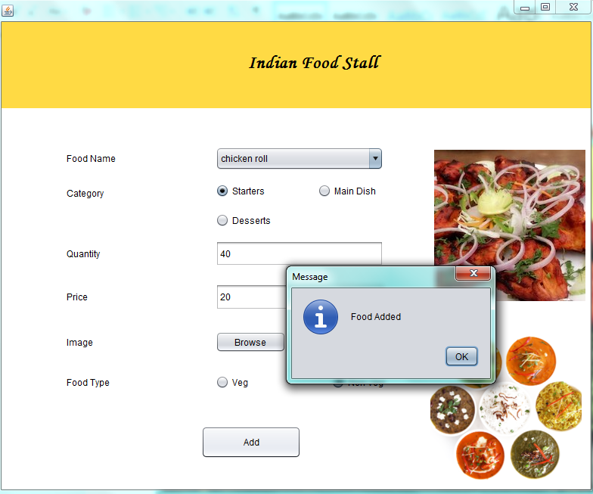

Slide 23
User Authentication
User authentication is a process that allows a device to verify the identity of someone.
The user authentication is to register their data to the admin.
The user login into the food stall want the food to add on cart.
The cart will manage by admin side.

Slide 24
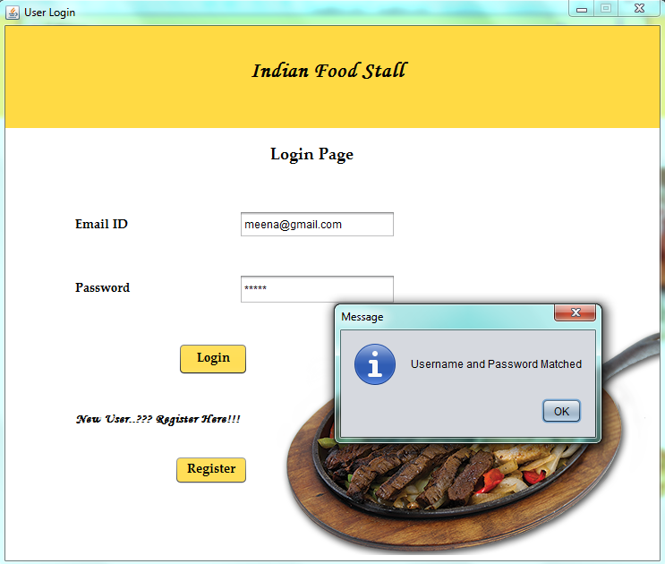

Slide 25
Cart Items
The cart items have veg and non-veg.
If we select the non-veg part.
It have a many sub menus like a chicken biryani, chicken tikka like that.
It is also handle by admin side.
The user will only login and select the food and purchase it.

Slide 26
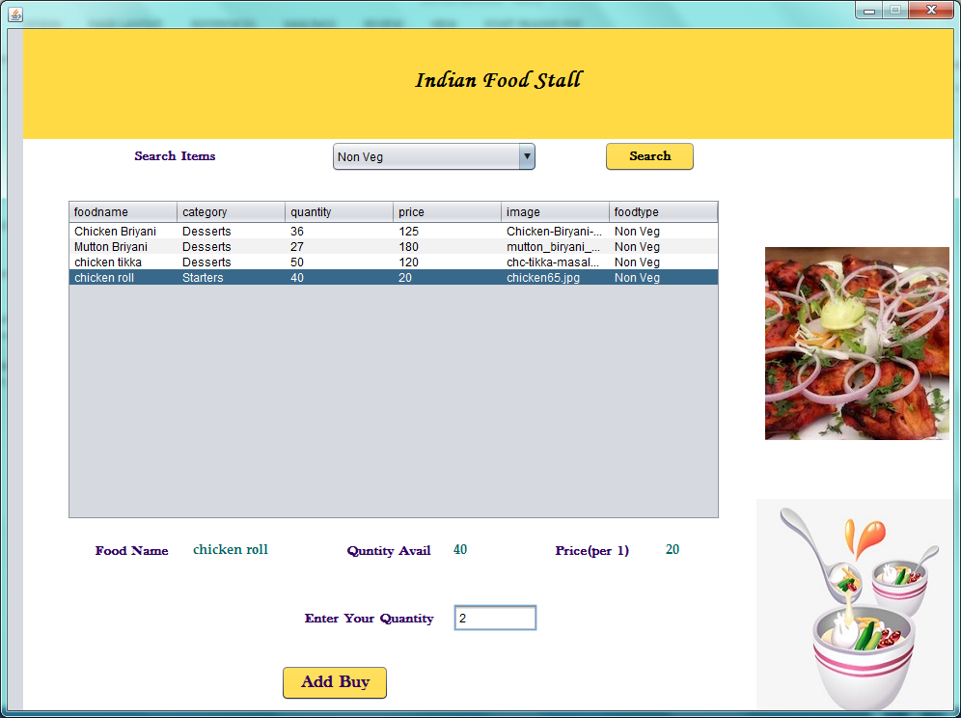

Slide 27
Delivery Status
The user add the food to the cart. If select the food by the user.
That food added to the cart and the food is to place on admin side.
The order message send to the user side.
The order is placed is to be a delivery status.
The delivery status is some alert to the confirmation of the user side.

Slide 28
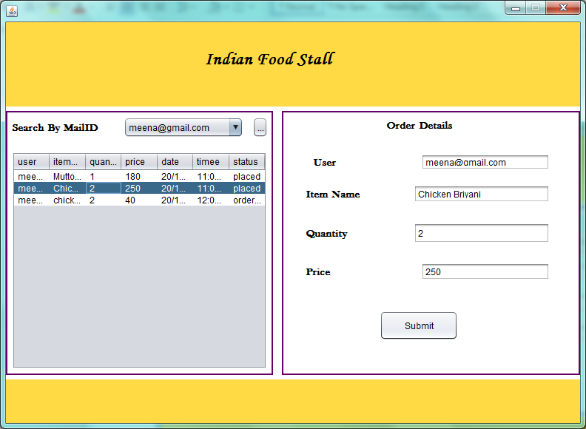

Slide 29
CONCLUSION
Thus our food stall management system achieves less time consumption then existing system.
Out food stall application also provide customer buyer relationship. The user can easily cart their foods on the place.

Slide 30
THANK YOU….!!

